Slide 1
EECS 4415 Project Canadian Political Sentiment Analysis via Twitter
Raymond Barakat, Matthew Longphee, Sami Tarazi

Slide 2


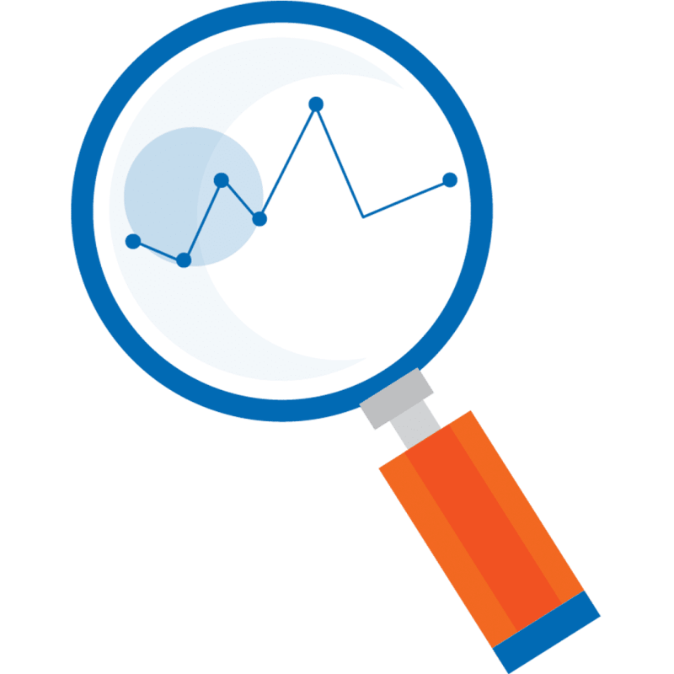

Introduction & Motivation
2019 Canadian Election – October 21, 2019
Wanted to analyze Political Canadian Twitter Data
Help Politicians:
- Understand public perception of their campaign
- Improve public sentiment about their campaign and themselves

Slide 3






What questions do we want to answer?
What is the political sentiment of a major Geo-location in Canada(ex. positive/negative /neutral)?
What is the political sentiment towards major politicians of each party?
What do people value in each province? (ex. Taxes, Economy, Education)
What are the most prominent hashtags and what is sentiment associated with each hashtag?
What is the current sentiment of each province in Canada?

Slide 4

Description of the data
Medium Sized Data Dimensions
10 Provinces, 338 Ridings across Canada
~800MB of Data
Amount of Tweets per Province & Ridings
~10k per province ~1 – 5k per Riding
Twitter Attributes
17 attributes (user ID, date, tweet, time zone etc.…)

Slide 5





Data Pre-Processing/After Processing
Province
Location
Google Translate French, Remove Emojis, Links, Non-Chars
Tweet Text
Date and Time
Twitter Data
Ridings
Riding zone
Location
Centre (long, Lat)
Search Zone

Slide 6
Batch Architecture & Data Flow
Data Ingestion
Data Storage
Data Processing
Data Analysis
Data Representation
Sentiment Analysis & NLP
Hadoop
DFS
Hadoop
MapReduce
Graph/Plot
CSV File

Slide 7
Streaming Architecture & Data Flow
Data Ingestion
Data Processing
Data Analysis
Data Storage
Data Representation
Spark Data-frame & Spark SQL
Spark Map Reduce
Sentiment Analysis & NLP
ChartJS &
Google Charts
Tweepy API

Slide 8
Analysis & Results

Slide 9
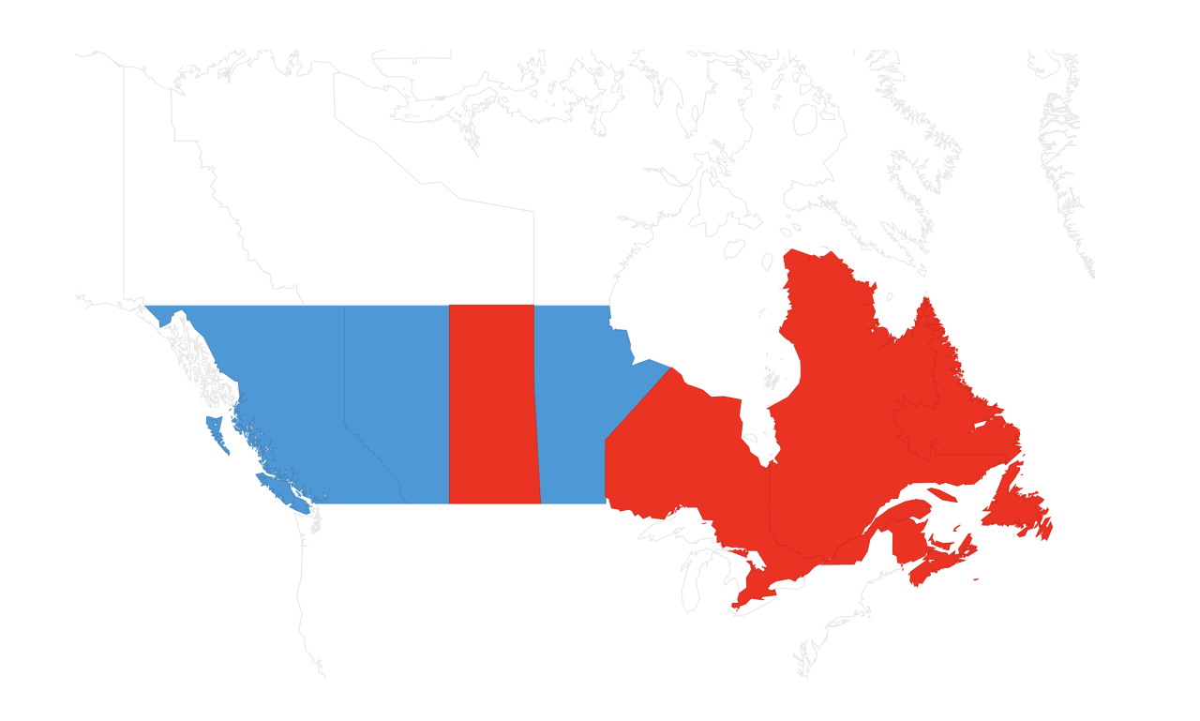
Political Sentiment Analysis for Provinces

Slide 10
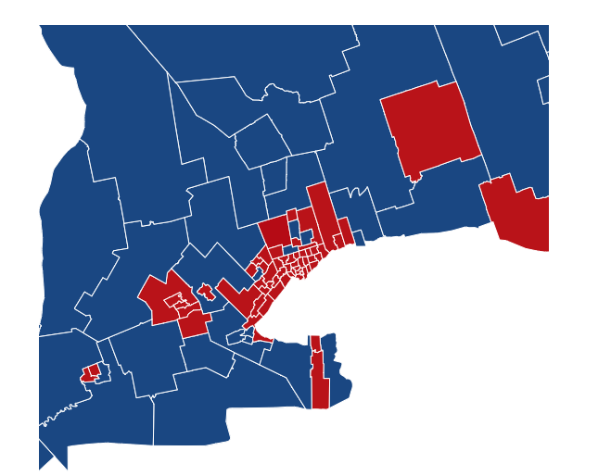
Political Sentiment Analysis for Ridings (Ontario)

Slide 11
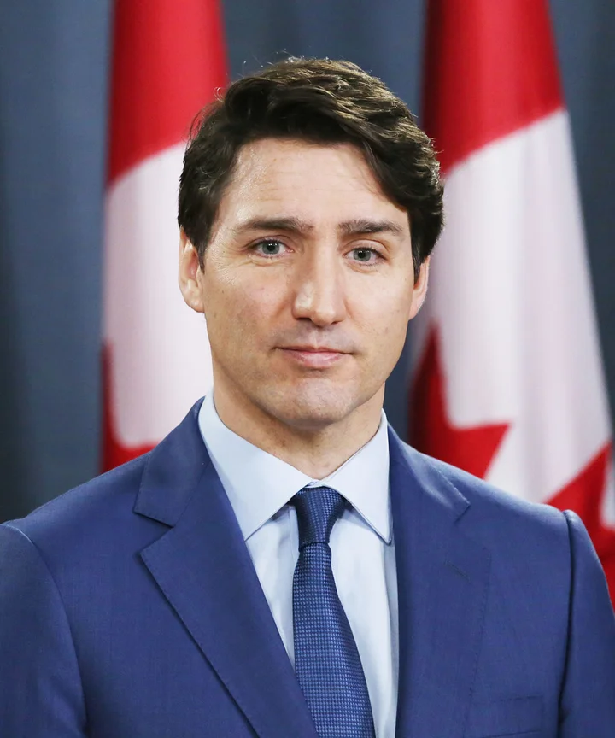


Politician Sentiment Analysis
50% Negative
43% Negative
35% Negative
21% Positive
28% Positive
46% Positive
29% Neutral
32% Neutral
19% Neutral

Slide 12
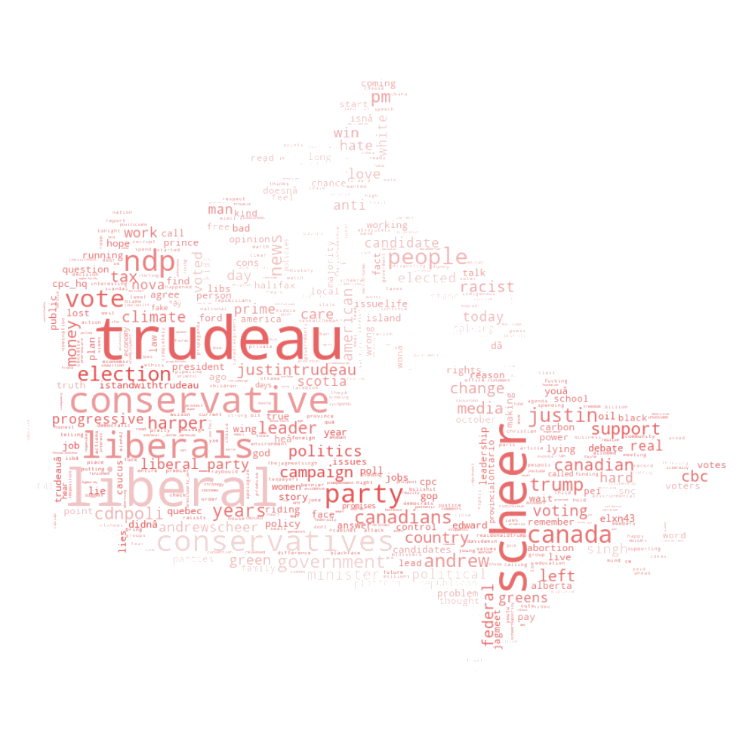
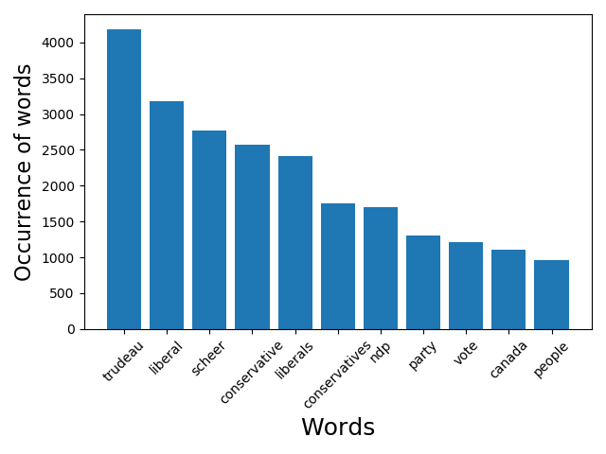
Text Analysis
Observations
Trudeau (4187) was mentioned twice as much as Scheer (2773)
Liberals (5,596) Conservatives (4,319)

Slide 13
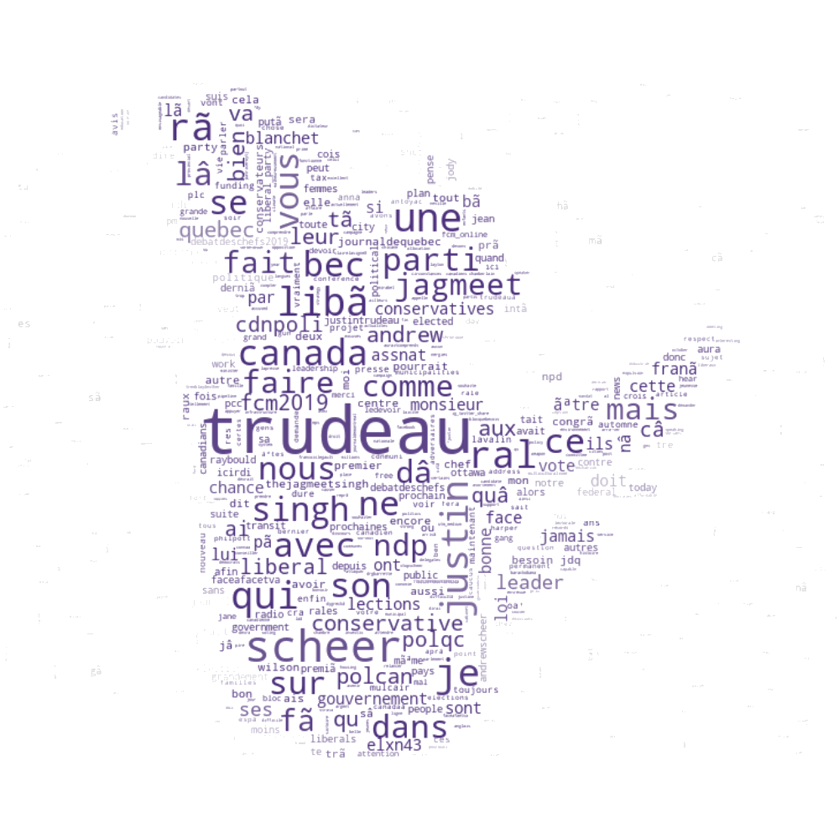
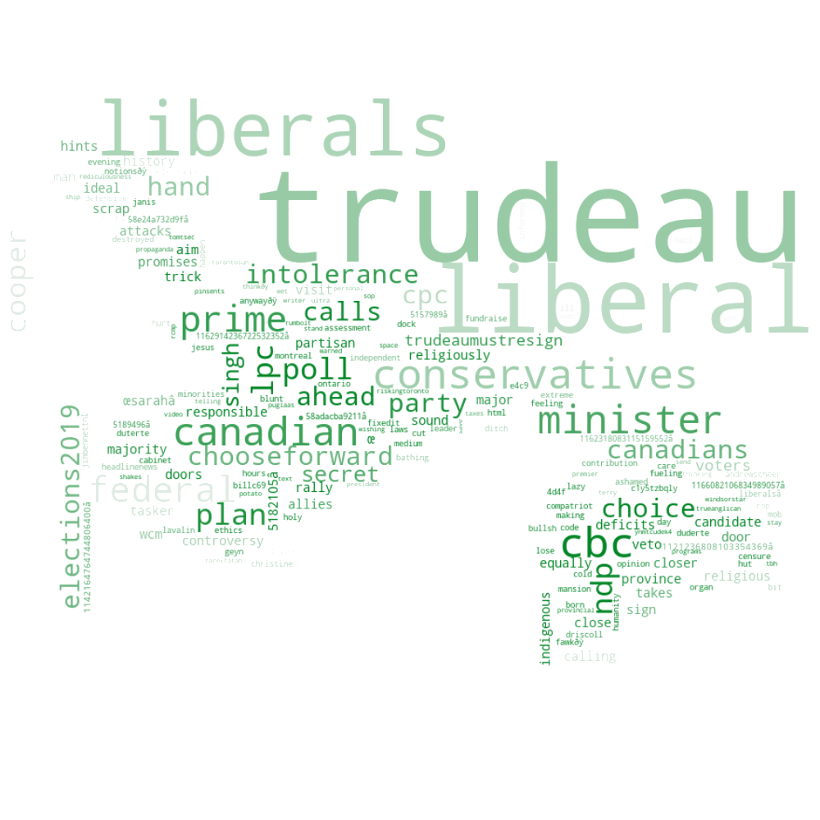
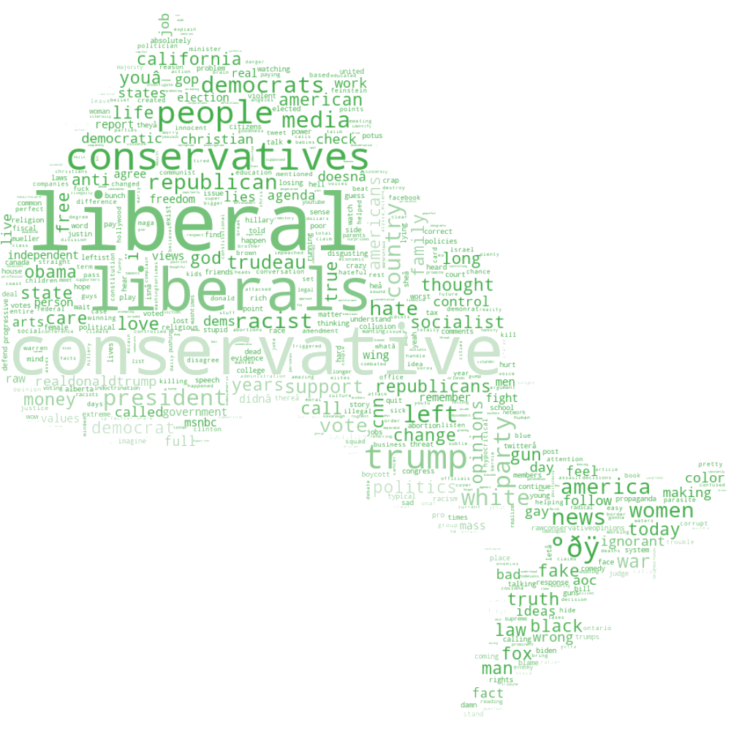
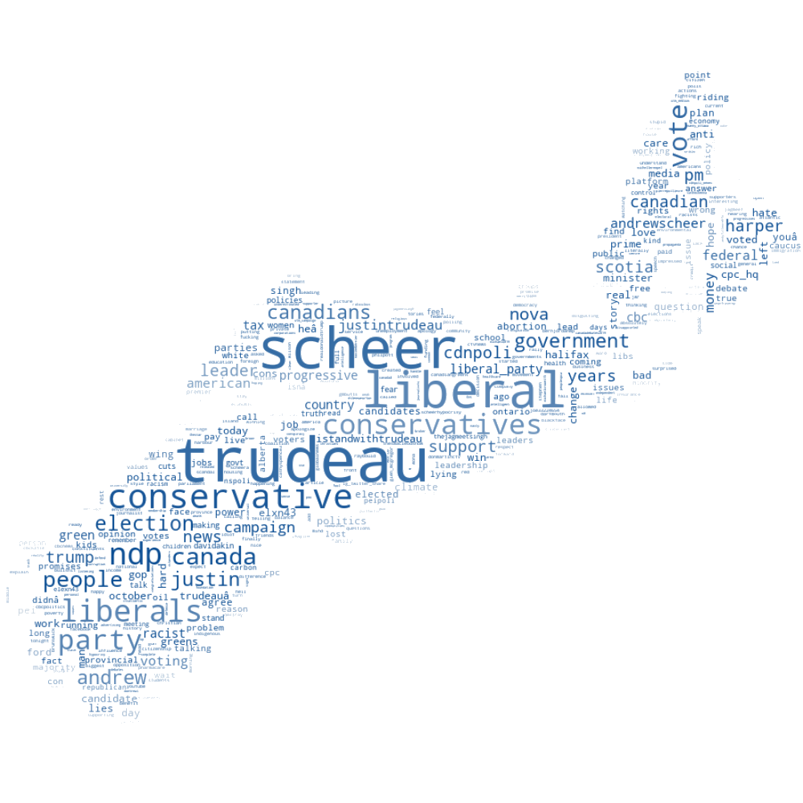
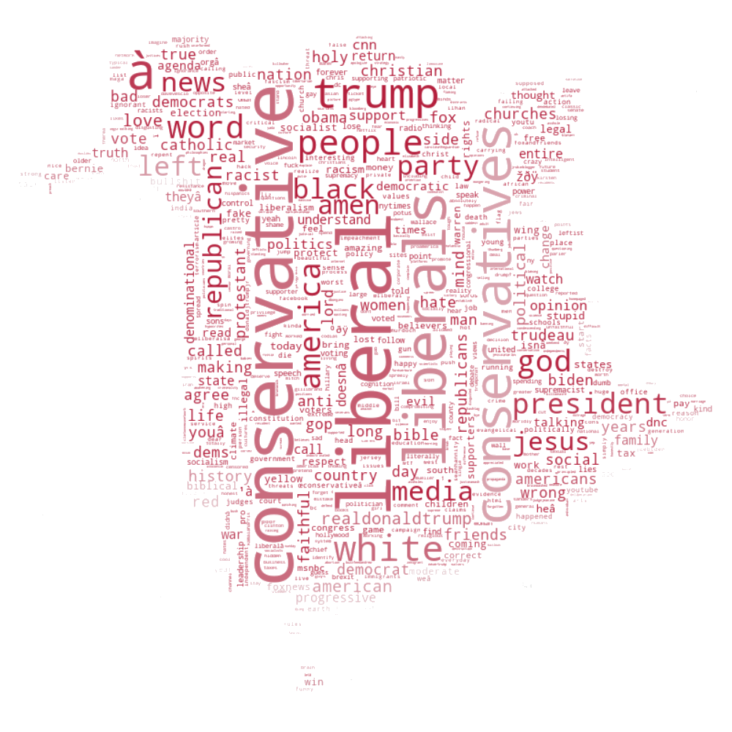
Text Analysis per Province

Slide 14
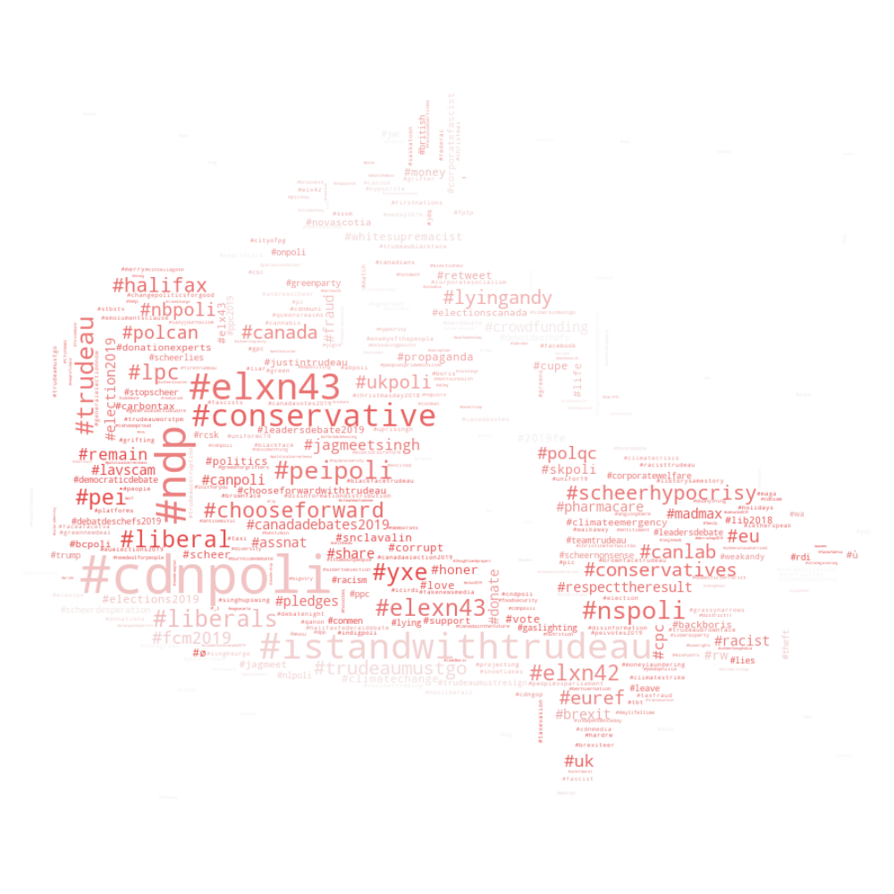
Hashtag Analysis

Slide 15
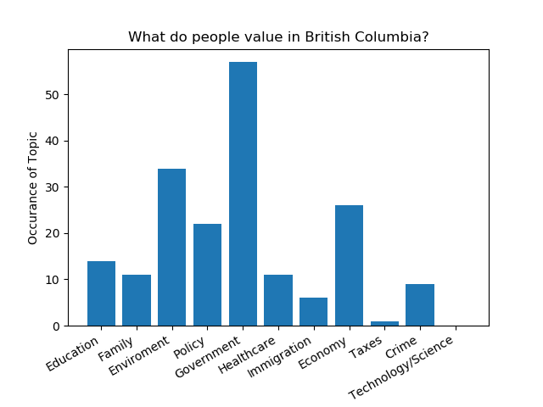
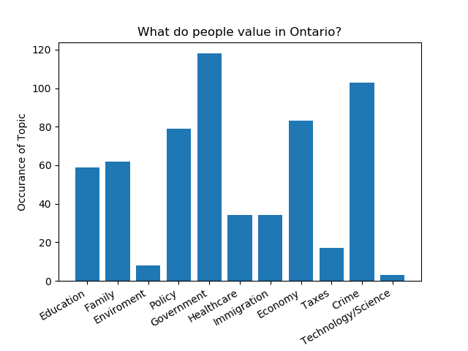
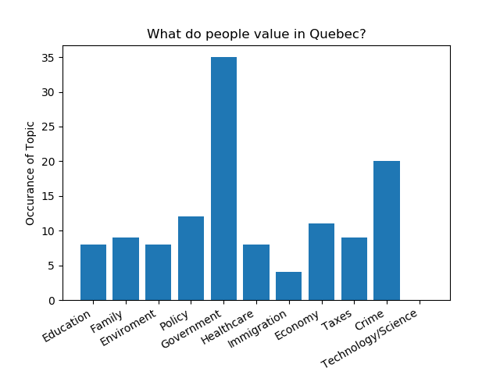
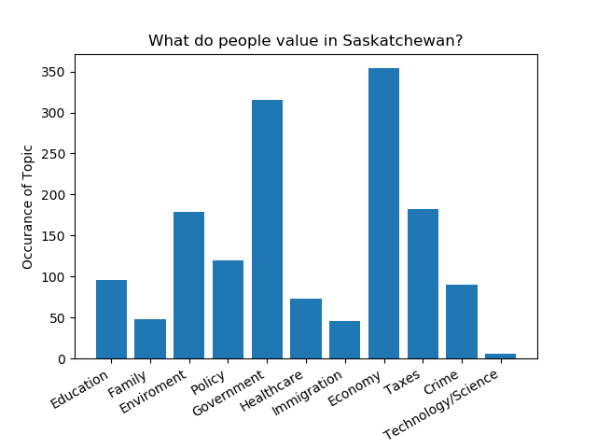
What do people value in each province?

Slide 16
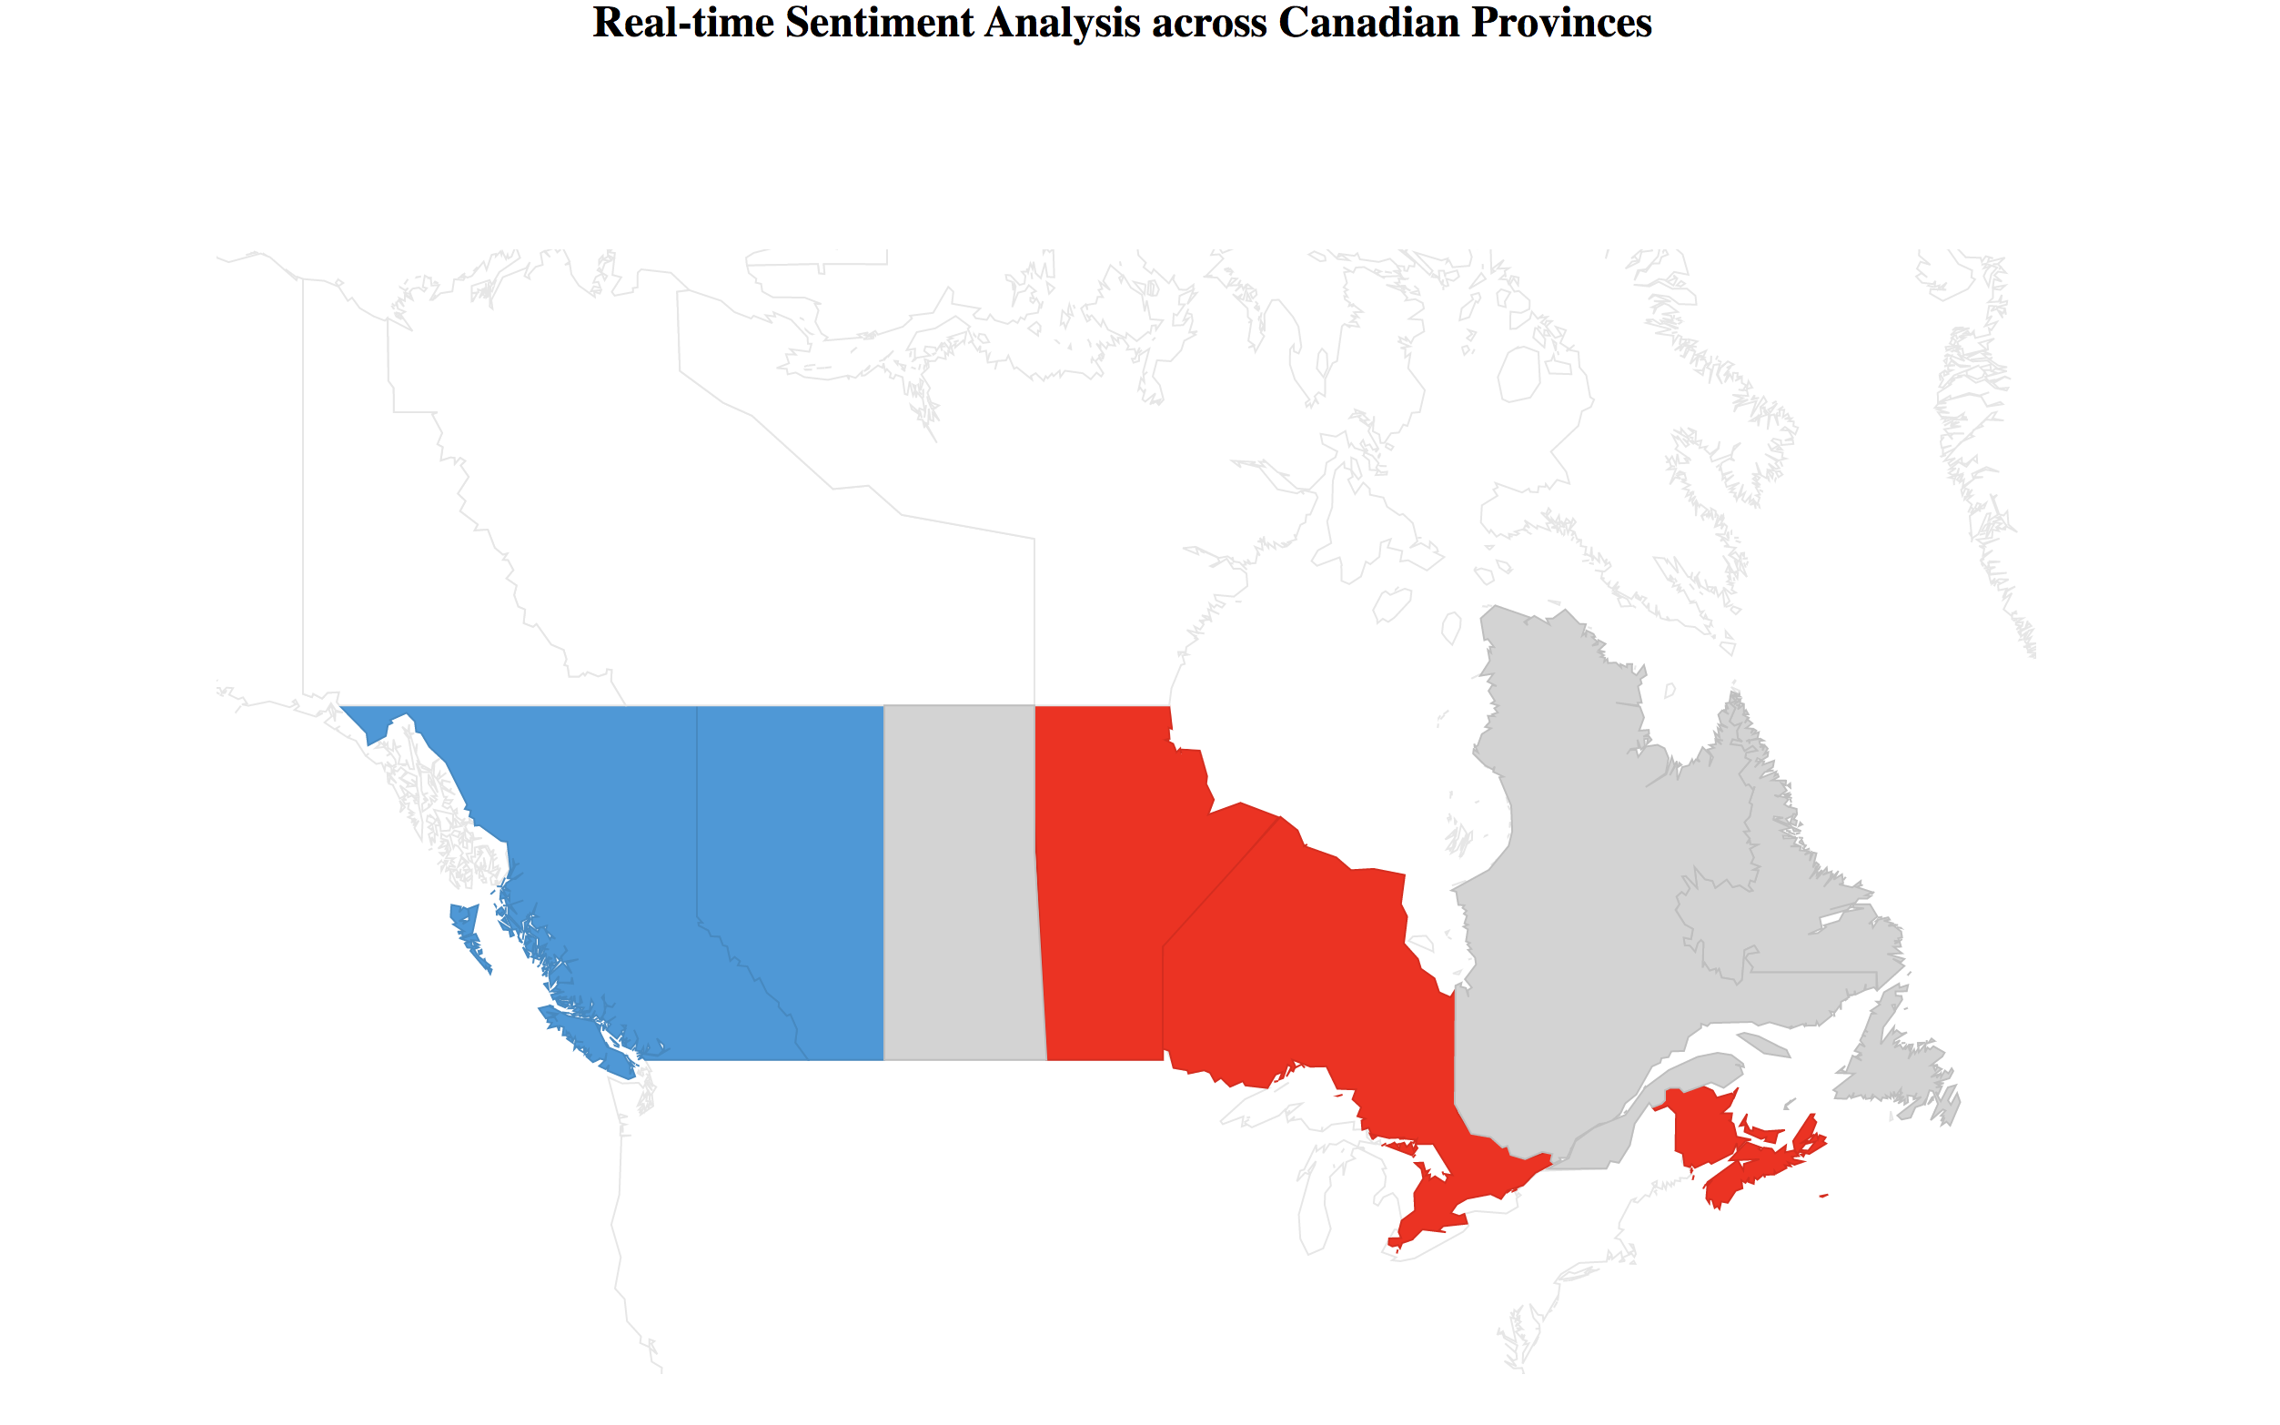
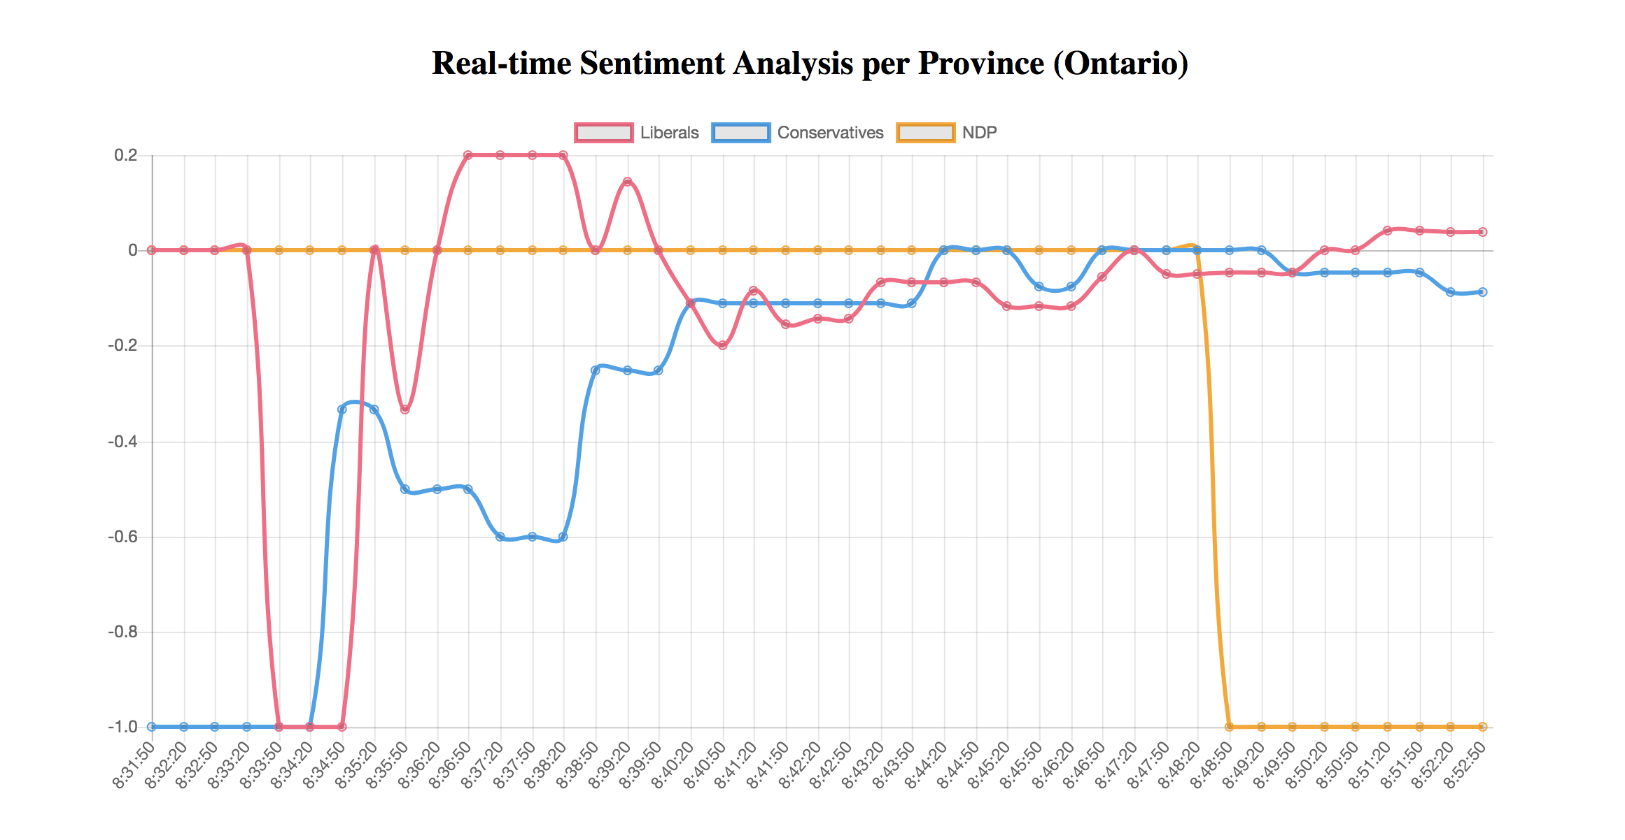

Slide 17
Conclusion

Slide 18
Interesting variations and limitations of the system
1
Using Polygons shapes to make up the ridings area
2
Machine Learning Classification Model
Determine the keywords that trigger the sentiment of real time tweets
3

Slide 19
References
“Twitter Sentiment Tutorial” https://www.geeksforgeeks.org/twitter-sentiment-analysis-using-python/
“Twitter API without using API” http://www.simonlindgren.com/stuff/2017/11/7/scrape-tweets-without-using-the-api\
“Machine Learning Twitter Sentiment”
https://towardsdatascience.com/creating-the-twitter-sentiment-analysis-program-in-python-with-naive-bayes-classification-672e5589a7ed
Apache Spark Streaming Tutorial: Identifying Trending Twitter Hashtags
https://www.toptal.com/apache/apache-spark-streaming-twitter
Twitter Trends Analysis using Spark Streaming
http://www.awesomestats.in/spark-twitter-stream/
Apache Spark Streaming with Twitter (and Python)
https://www.linkedin.com/pulse/apache-spark-streaming-twitter-python-laurent-weichberger/

